Slide 1
Програмиране и Интегриране на Софтуерни Системи
Week 6
Remote Method Invocation (RMI)
1-<number>

Slide 2
LECTURE PLAN
  Middleware
    Disadvantages of Sockets
    Local vs. Remote calls
    Layers
    Advantages of Middleware
  Java RMI Technology
  RMI Application Development
  Java Naming Service
1-<number>

Slide 3
Middleware – Drawbacks of Sockets
  Manual mapping of complex parameters to byte streams
  Manual resolution of data heterogeneity
  Manual identification of components
  Manual implementation of component activation
  No guarantees of Type Safety
  Manual synchronization of interaction between distributed components
  No QoS guaranteed

Slide 4
Middleware - Local vs. Remote Call
Called
Caller
Caller
Caller
Called
Stub
Stub
Transport Layer (e.g. TCP or UDP)

Slide 5
Middleware – Layers
Applications
Middleware Layers
Referencing, Marshalling,
Threading, Serializing,
Synchronizing, etc.
Operating Systems

Slide 6
Middleware - Advantages
Layered between Application and OS/Network
Resolves heterogeneity of
  Hardware
  Operating Systems
  Networks
  Programming Languages
Makes distribution transparent through unfying
  Local
  Remote
Provides development and run-time environment for distributed systems.

Slide 7
LECTURE PLAN
  Middleware
  Java RMI Technology
    RMI as client/server technology
    RMI layers
    RMI vs. sockets
  RMI Application Development
  Java Naming Service
1-<number>

Slide 8
Java Remote Method Invocation (RMI)
Enables objects in different JVMs to call each other’s methods
  only Java-to-Java interaction supported
  based on CORBA specification
Extension to the Java language
  part of the core JDK
  can pass objects directly (by value) as arguments (after serialization)
  distributed garbage collection
  mobile code
1-<number>

Slide 9
RMI - Java RMI as Client/Server Technology
A remote object is one whose instance exists in another virtual machine, which may be running on a remote node but can be local as well.
Servers define and instantiate objects that clients can use remotely via remote interfaces.
Clients invoke methods on remote objects (after binding to them via remote references).
Arguments and return values can be primitive values or more complex serializable objects.
1-<number>

Slide 10
RMI - Java RMI Layers
App
Client Application
Application
Layer
Server Application
Proxy
Layer
Pre-RMI v1.2
Client Stub
Server Skeleton
RMI middleware
Remote Reference
Referencing
Layer
Remote Interface
Transport Layer
1-<number>

Slide 11
RMI - Application Layer
Java VM
Java VM
NETWORK
Object 1
Object 2
Remote method invocation
CLIENT HOST
SERVER HOST
1-<number>

Slide 12
RMI – Proxy Layer
Java VM
Java VM
NETWORK
Server
Object
Client
Object
Marshaling
Marshaling
Client
Stub
Server
Skeleton
Network communication
CLIENT HOST
SERVER HOST
1-<number>

Slide 13
RMI - Remote Reference Layer (RRL)
On the client side, RRL receives remote reference and marshalled arguments from the stub
Forms communication request to the remote object using one of the two supported methods
  unicast (default)
  multicast
On the server side, RRL directs incoming request to either the target skeleton (pre v1.2) or directly to the remote server.
1-<number>

Slide 14
RMI - Transport Layer
Transmits remote method invocation requests between different JVMs Java using binary data protocol (known as a ‘wire level’ protocol)
  RMI transport layer is implemented over standard TCP/IP transport protocols as RMI connections are essentially stream-based network connections.
Different RMI transport layer protocols are possible (e.g. JRMP, IIOP)
  The standard Sun implementation of RMI uses IIOP (the standard CORBA protocol) and this way RMI is CORBA compatible
1-<number>

Slide 15
RMI - Java RMI Calls vs. Sockets
Message Passing
Message Passing through Sockets provides better performance for small applications with simple message passing needs (e.g., through using UDP datagrams or SMS messages).
  However, with Message Passing catalog of messages gets complex and hard to maintain in larger applications.
  Serialisation/Marshalling needs to be carried out manually in Message Passing.
RMI provides additional support, Message Passing (potentially) provides better performance.
1-<number>

Slide 16
LECTURE PLAN
  Middleware
  Java RMI Technology
  RMI Application Development
    Components
    API
    Utilities
    Step-by-step
  Java Naming Service
1-<number>

Slide 17
RMI Application Development
The business code you write - similar to a local Java SE client/server application except:
  Remote Exceptions may be thrown at any time and must be handled within the client
  Distributed method calls can be an order of magnitude slower and may need garbage collection
  Deadlocks are possible and need to be monitored
The software development API you need is in Java SE (package java.rmi)
The runtime you use is also in Java SE (interpreter java.exe and naming service rmiregistry.exe)
1-<number>

Slide 18
RMI Development - Components
–
Java Application Layer
Local
Object
Remote
Interface
Remote
Service
«implements»
«uses»
«implements»
«uses»
(pre v1.2)
RMI Middleware
Stub
Skeleton
Remote Reference
Layer
pre v1.2
OS Transport Layer
1-<number>

Slide 19
RMI Development – Utilities
rmic – RMI Compiler for generating stubs and skeletons (obsolete since Java 7)
rmiregistry – RMI naming service (either standalone or embedded in the server)
rmid – RMI activation daemon (used only If activation is needed)
1-<number>

Slide 20
RMI Development - API
java.rmi - client-side RMI classes, interfaces and exceptions
java.rmi.server - Server-side RMI classes, interfaces and exceptions
java.rmi.registry - RMI Naming services
java.rmi.dgc - Distributed garbage collection
java.rmi.activation - Activation of remote objects on demand
1-<number>

Slide 21
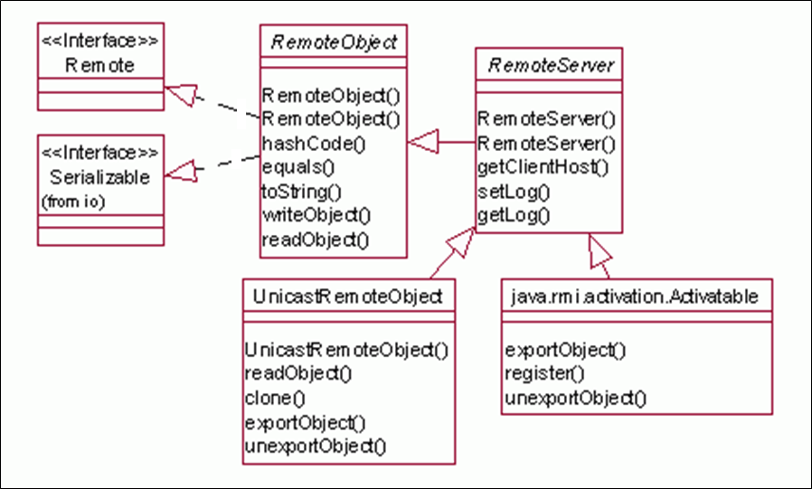
RMI Development – API Diagram
1-<number>

Slide 22
RMI Development – Remote Interface
A remote interface declares all methods that are called from other JVMs
  Remote methods must be declared public
  Extends java.rmi.Remote interface
Each method must declare java.rmi.RemoteException in throws clause
Any remote object passed as a parameter or returned as value must be declared as a remote interface type, not as an implementation class type
1-<number>

Slide 23
RMI Development - Remote Objects
Write source files:
  Define remote methods in an interface
  Write server/implementation classes
  Write client application.
Compile and deploy class files
  Use javac to compile source files
  Use rmic to generate stubs/skeletons (pre Java SDK 6)
Start RMI registry, server, and client
1-<number>

Slide 24
RMI Development - Stubs
Generated separately by rmic compiler (pre Java SDK 6) or automatically when remote server compiled (post Java SDK 6)
Stub lives in the client address space and acts as a proxy for the remote object
Maintains internal reference to remote object it represents
Stub ‘marshalls’ method arguments into a serialized form so the parameters must be serializable
1-<number>

Slide 25
RMI Development - Skeletons
Skeleton lives in the server address space and acts as a server-side proxy for the remote object
RMI Skeletons ‘unmarshalls’ method arguments
Arguments that are remote references themselves result in creation of a local stub
Marshalls return argument
Note: Skeletons were deprecated as of RMI v1.2, with their functionality being handled by the server-side Remote Reference Layer
1-<number>

Slide 26
LECTURE PLAN
  Middleware
  Java RMI Technology
  RMI Application Development
  Java Naming Service
    API
    Proxies
    URLs
    Implementation
1-<number>

Slide 27
Java Naming Service
A common technique in distributed computing that allows a client to acquire a proxy to a remote object is to use a naming service
  Java RMI provides a simple naming service where the names are (case-sensitive) strings
  The naming service provides a mapping from names to proxy objects in the RMI registry
1-<number>

Slide 28
Java Naming Service - Proxies
    The client forms a remote request to the RMI registry for a service under specific name and gets its proxy
    Remote objects which can be transported across the network retaining the consistency of the references
But how can a client, running in a different JVM, get hold of the proxy locally?
1-<number>

Slide 29
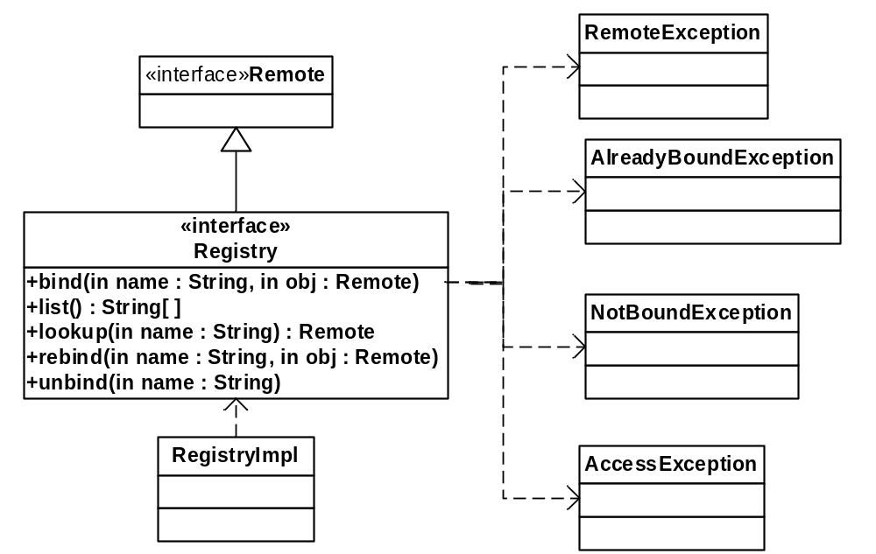
Java Naming Service – API
java.rmi.registry.Registry is RMI’s naming service
  Registry specifies the interface of the naming service
  Java SDK includes a default implementation class, RegistryImpl
1-<number>
Notes:
Registry is just another Remote interface.

Slide 30
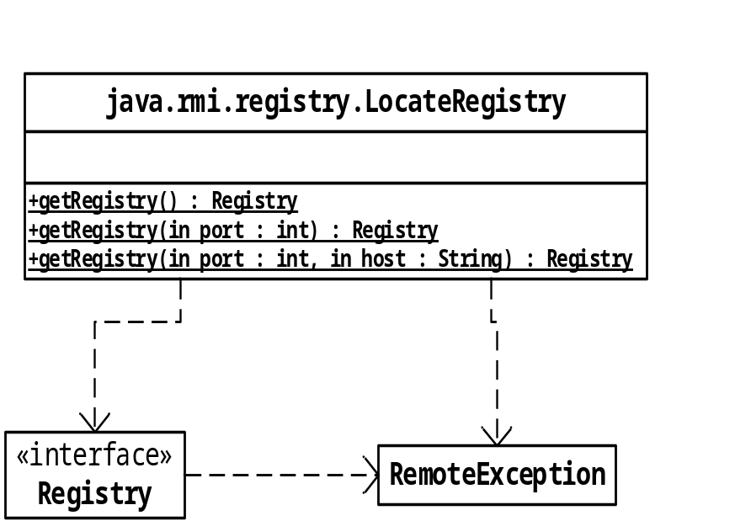
Class LocateRegistry
Class LocateRegistry includes a set of static methods that return a proxy representing a remote Registry object
Returns a default proxy for a Registry object running on the local machine and listening on port 1099.
Specifies the location where the Registry object is expected to be executing if not locally
Note: a getRegistry() call does not make a connection to the remote Registry object. It simply creates a proxy object for it locally – this succeeds even if the remote Registry object is not actually running. But subsequent method invocations on the proxy may fail if it hasn’t been generated correctly, or if the remote object is not running
1-<number>
Notes:
1099 is the default port used by a Registry object.
LocateRegistry knows how to create a proxy for a Registry implementation. It can do this because the Registry interface is specified as part of the JDK. The class file for Registry’s stub class is part of the JDK classes.

Slide 31
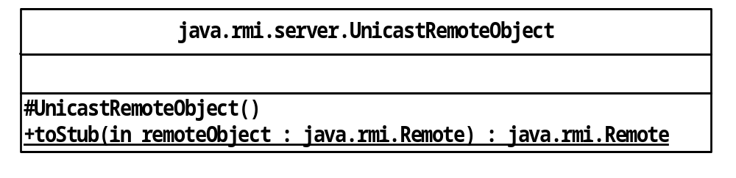
Class UnicastRemoteObject
The UnicastRemoteObject class provides a static method toStub() to generate a local proxy object (i.e., stub) for any remote object invocation
CreditCheckerImpl creditCheckerImpl = new CreditCheckerImpl( );
CreditCheckerImpl proxy =
(CreditCheckerImpl)UnicastRemoteObject.toStub(creditCheckerImpl);
By issuing a remote request to the RMI registry the client gets hold of the proxy which is then transported back to the client to be used locally
1-<number>
Notes:
A stub (proxy) object encapsulates the location of the remote object it represents.
Asking a remote object for its corresponding proxy is all well and good, but this needs to be communicated to the client – in a different JVM.

Slide 32
Class Registry
:creditCheckerImpl_Stub
Registry JVM
“creditChecker”
“CalculatorServer”
…
: RegistryImpl
:CalculatorImpl_Stub
RMI run-time
To start up the naming service:
  Running registry starts up a new JVM in which a Registry implementation object listens for incoming requests
rmiregistry
1-<number>
Notes:
rmiregistry is an executable in the JDK bin directory.

Slide 33
Using Registry methods
Client JVM
2: lookup()
RMI run-time
Registry JVM
:RegistryImpl
Server JVM
RMI run-time
:creditCheckerImpl
RMI run-time
1: bind()
How does a server get a proxy for the remote Registry object so that it can register a proxy for its :creditCheckerImpl object?
How does a client get a proxy for the remote Registry object so that it can retrieve a proxy for a remote :creditCheckerImpl object?
1-<number>

Slide 34
public class Client {
public static void main (String[] args) {
try {
Registry registryProxy = LocateRegistry.getRegistry();
CreditChecker checkerProxy =(CreditChecker) registryProxy.
lookup(“CreditChecker”);
boolean balanceOK = checkerProxy.check(personAcc);
}
catch(RemoteException e) {
System.err.println( “Remote exception “ + e);
}
}
}
public class Server {
public static void main (String[] args) {
try {
CreditCheckerImpl checker = new CreditCheckerImpl ();
Registry registryProxy = LocateRegistry.getRegistry ();
registryProxy.bind(“CreditChecker”,checker);
}
catch (RemoteException e) {
}
catch (MalformedURLException e) {
}
}
}
The client, server and Registry object are assumed to be running on the same physical machine.
1-<number>

Slide 35
Client JVM
RMI run-time
2:lookup (“CreditChecker”)
registryProxy
Registry JVM
checkerProxy
:CreditCheckerImpl_Stub
:RegistryImpl
“CreditChecker”
3:check(personAcc)
RMI run-time
Server JVM
:CreditCheckerImpl
1: bind (“CreditChecker”,
«checker’s stub»)
RMI run-time
registryProxy
1-<number>

Slide 36
Class Naming
Naming is a convenience class that mirrors any local Registry object remotely, so it can be used instead of to call the objects locally instead of Remote
In response to a Naming method call, like in the Remote lookup(…) call, the following happens:
  The name argument passed to the Naming method (e.g., lookup(“CreditChecker”) is parsed and passed as the argument to LocateRegistry’s get() method
  LocateRegistry returns a proxy object for the remote Registry object
  The Naming class uses the proxy object found in the registry to invoke the corresponding method on the remote Registry object
1-<number>
Notes:
Note Naming provides only class (static) methods.
In practice, Naming is used instead of LocateRegistry.

Slide 37
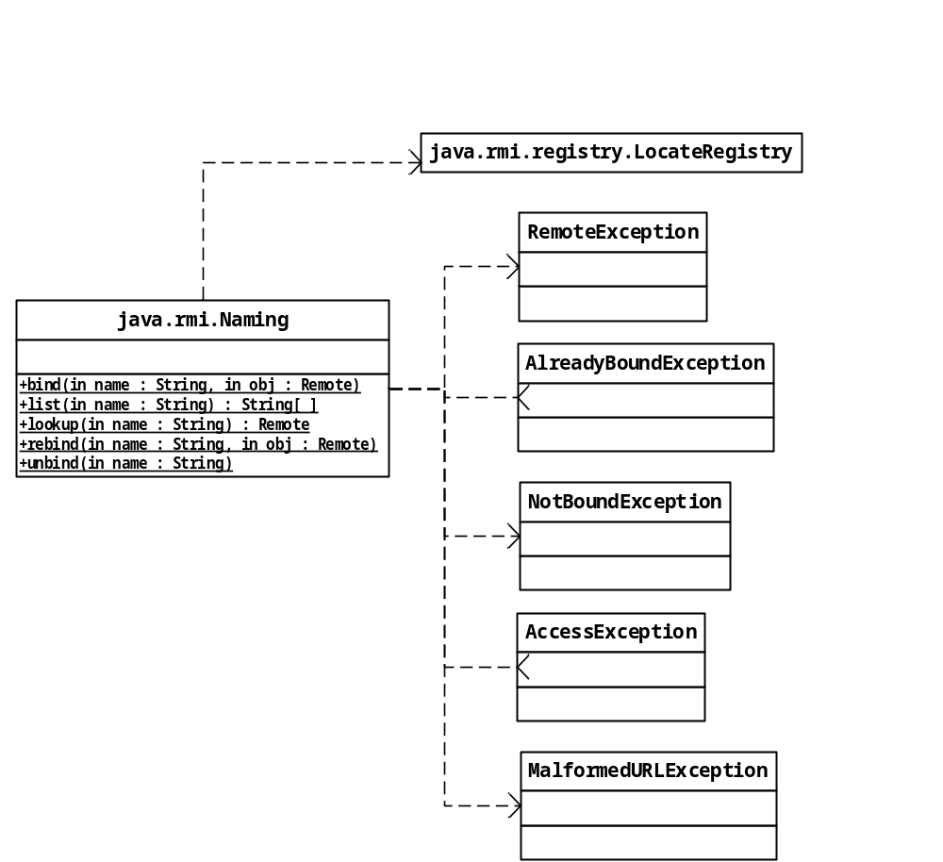
Class Naming
The name argument for all methods identifies both the location of the Registry and the name of the Remote object for which a proxy is required.
1-<number>
Notes:
Note Naming provides only class (static) methods.
In practice, Naming is used instead of LocateRegistry.

Slide 38
public class Client {
public static void main (String[] args) {
try {
CreditChecker checkerProxy=
(CreditChecker) Naming.lookup(“CreditChecker”);
…
}
catch (RemoteException e) { ...
/* Will also catch AccessException subclass of RemoteException. */
}
catch (NotBoundException e) { ...
}
catch (MalformedURLException e) { ...
}
}
public class Server {
public static void main (String[] args) {
try {
CreditCheckerImpl checker = new CreditCheckerImpl();
Naming.rebind (“CreditChecker”,checker);
}
catch(RemoteException e) { ...
}
catch(MalformedURLException e) { ...
}
}
}
1-<number>
Notes:
Where the Registry is running in a separate JVM, the proxy is serialised and sent to the Registry.
Parameter passing – stub always substituted to get pass by reference.

Slide 39
Java Naming Service - URLs
The name argument of Naming’s methods is a URL-formatted string:
  //hostname:port-number/service-name
  //myserver.londonmet.ac.uk:1099/MyAccount
Taken together, hosthame and port-number identify the machine on which the Registry implementation is running and the port number it is listening on
service-name identifies the logical name of the remote object whose proxy is held by the Registry
hostname and port-number both have default values:
  hostname – “localhost”
  port-number – 1099
{
//localhost:1099/MyAccount
//localhost/MyAccount
:1099/MyAccount
MyAccount
These are all equivalent names
1-<number>

Slide 40
Java Naming Service - What should go to the registry?
Not every remote object !
  Various factories which produce remote objects
  High-level service objects of importance only
Example: In banking application this is BankTeller object that creates Account objects on demand, not the Account objects themselves
1-<number>

Slide 41
Java Naming Service – Registry Implementation
To create your own server you need bootsrapping
  The JDK includes the Registry interface, a default implementation class RegistryImpl and a proxy class RegistryImpl_Stub
  Any Java program can communicate with a remote registry by:
    Creating a RegistryImpl_Stub local instance using the methods of LocateRegistry class
    Using the RegistryImpl_Stub object to access a remote object RegistryImpl object to obtain a proxy for a remote app object
The RMI registry is easy to use
  Simply use the Naming class to interact with the naming service
But there are some limitations:
  There are no searching facilities, e.g. “give me all the proxies for accessing remote objects that implement the Printer interface”
  The Registry does not support fault tolerance (no backup)
  Its scalability is limited as it has a flat structure (no virtual folders)
  Only remote objects running on the same physical machine as the registry can be registered with it (no version compatibility support)
1-<number>
Notes:
CORBA includes a more sophisticated naming service which is hierarchical and a yellow-pages style trading service.

Slide 42
Summary: RMI vs. Sockets
 | Sockets | RMI
Operations | Only data transportation | Data processing using remote method invocation
Data | Only primitive data types | All primitive data types plus all serializable data types
Session Maintenance | Available only in TCP sockets | Always available in IIOP
Speed | The highest possible in TCP | Slightly lower speed due to the additional bits in IIOP
Network Management | Easily blocked | Less vulnerable due to additional control
Error Management | No error control | Error recovery possible through remote exceptions
Development Process | Simpler | More complex due to the naming, search and proxy
1-<number>

Slide 43
On-line RMI Resources
Main Java RMI Resources
http://java.sun.com/javase/7/docs/technotes/guides/rmi/index.html
Object Serialization
http://java.sun.com/javase/7/docs/technotes/guides/serialization/index.html
RMI Activation
http://java.sun.com/javase/7/docs/technotes/guides/rmi/activation/overview.html
1-<number>

